Slide 1
Image Registration for Particle Detection
Derin Sevenler
Group meeting 9/4/13

Slide 2
Motivation
Want to count nanoparticles of unknown size – particle size is a measurement, rather than a filter
Some spots result in negative counts – what’s going on?
The correct intensity threshold is not the same for all images?

Slide 3
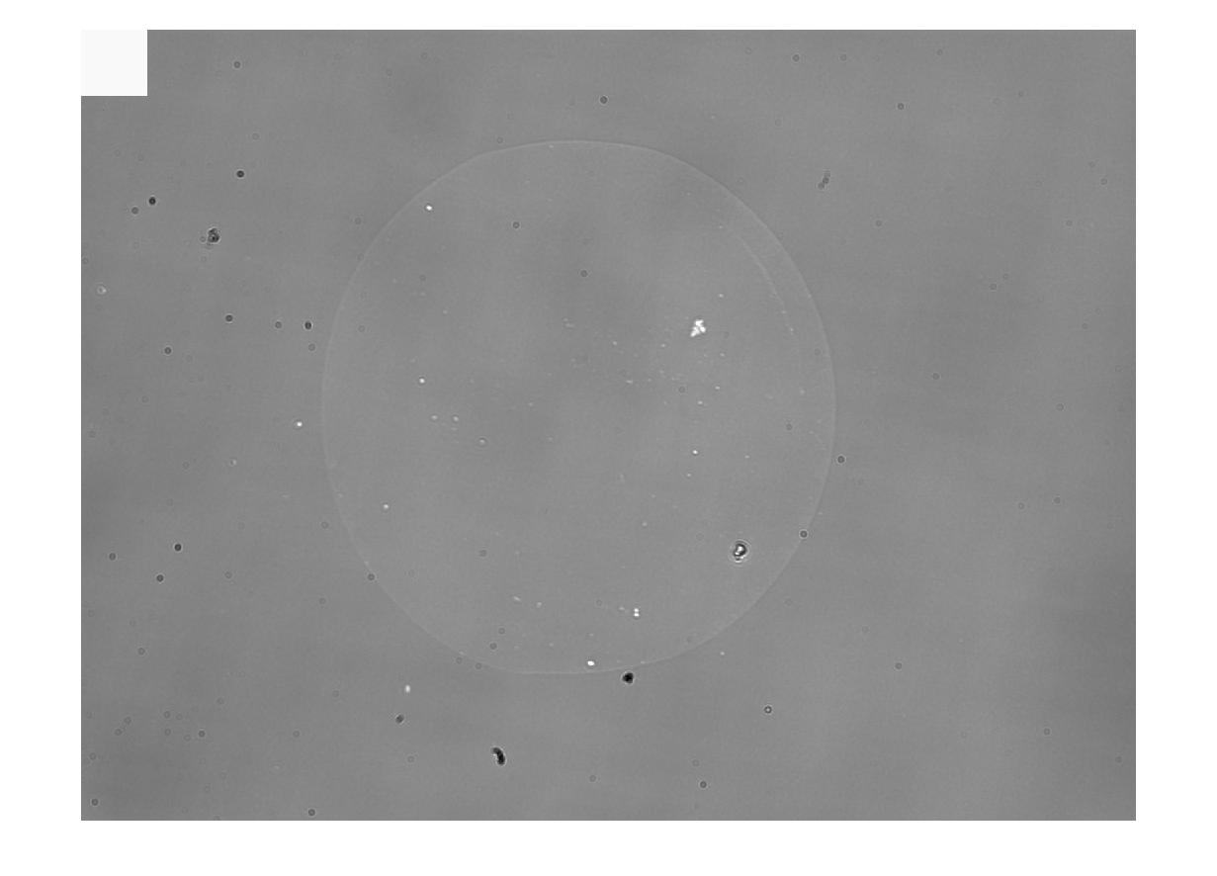
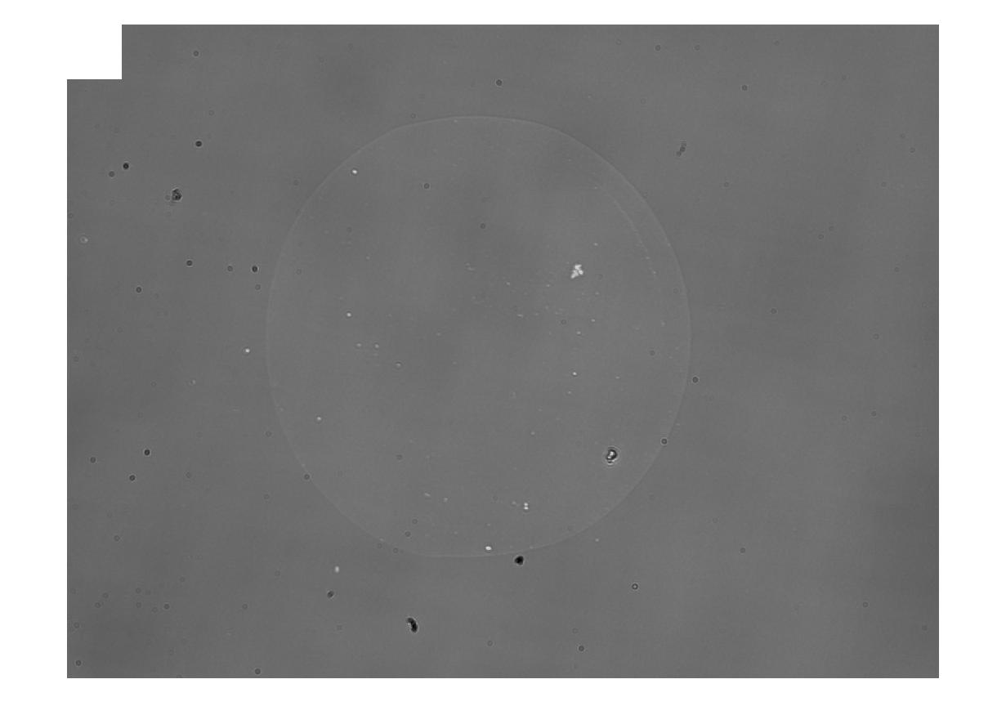
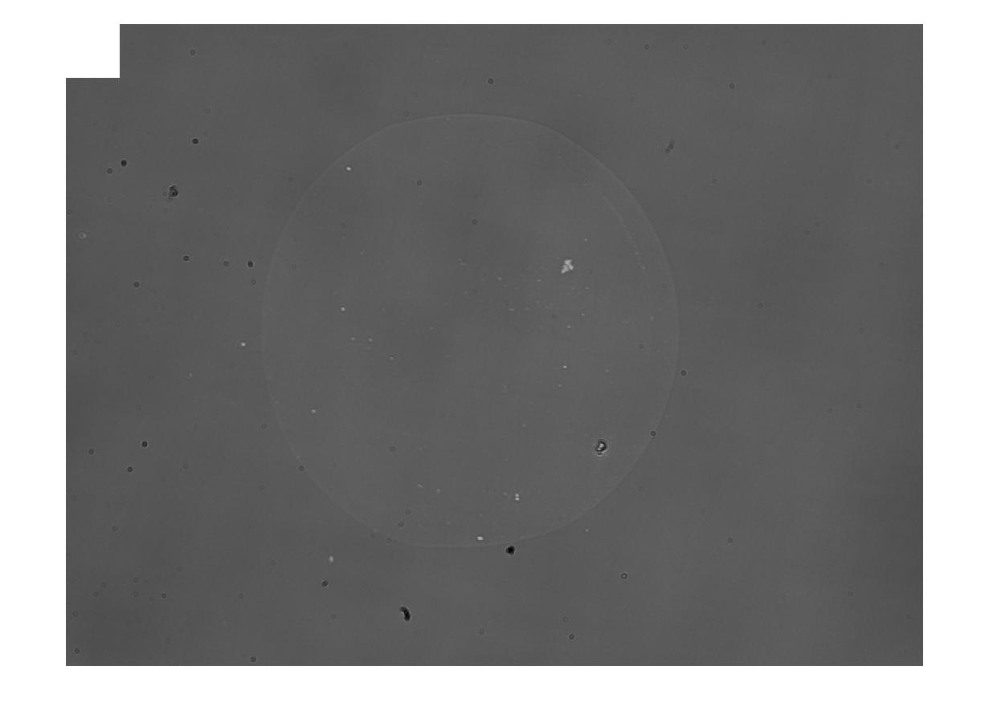
Overall brightness effects SIFT
Maximum brightness 4096 5000 6000
Particle Counts 505 321 246

Slide 4
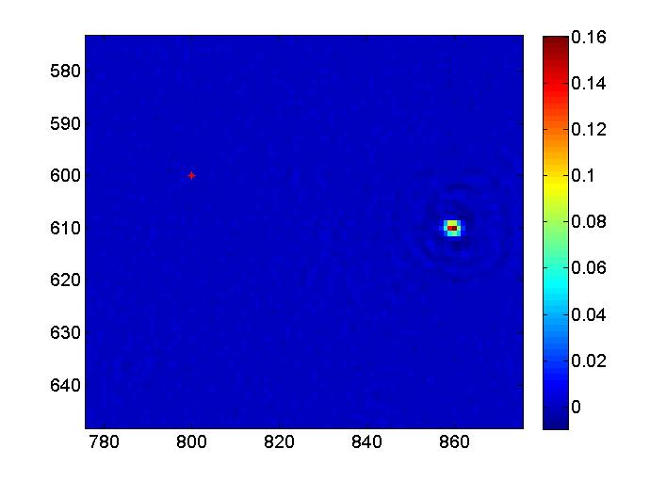
Image Registration
Determine (x,y) offset with Phase Correlation
A displacement in ‘real’ space corresponds to a ‘phase shift’ in Fourier-space.

Slide 5
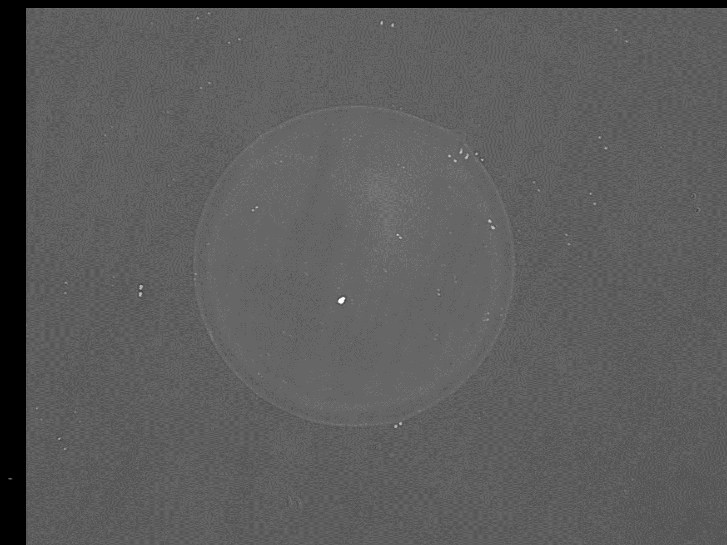
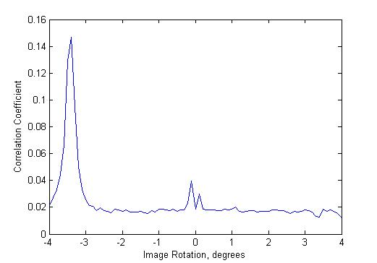
Determine offset angle by performing PC over a range of angles

Slide 6
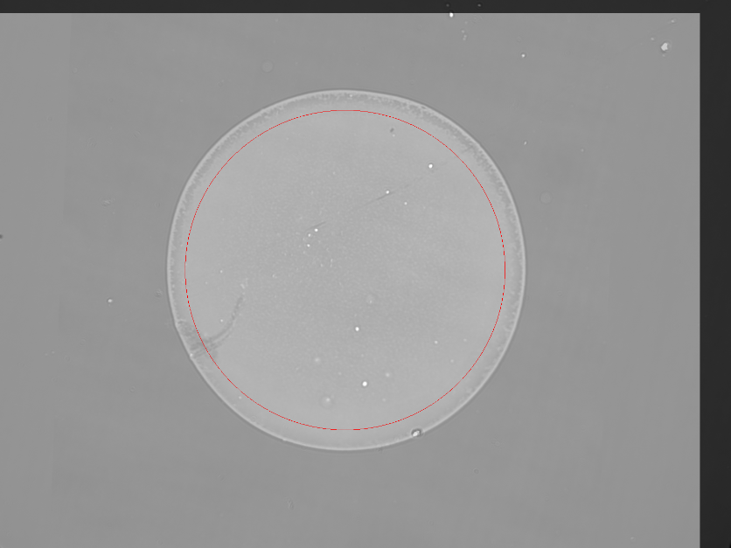
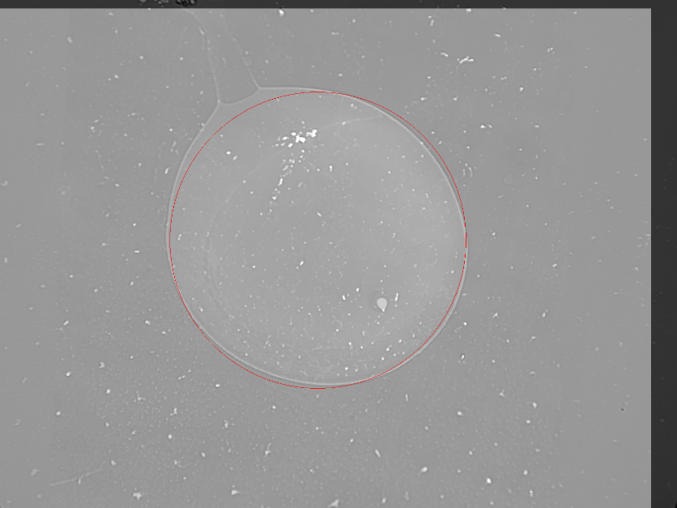
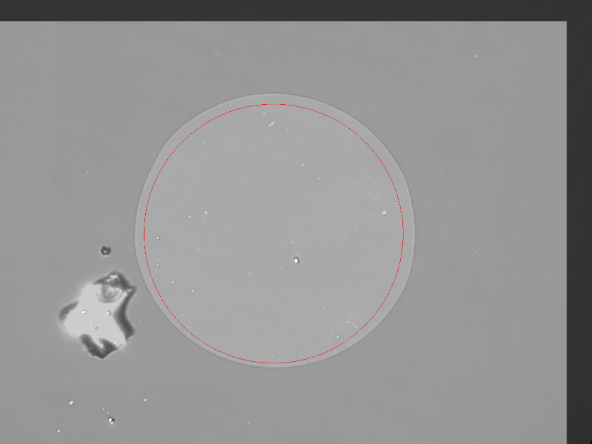
Find the spot in the composite image
Circle detection is performed only once (instead of twice)
Precisely the same region is cropped in both images

Slide 7
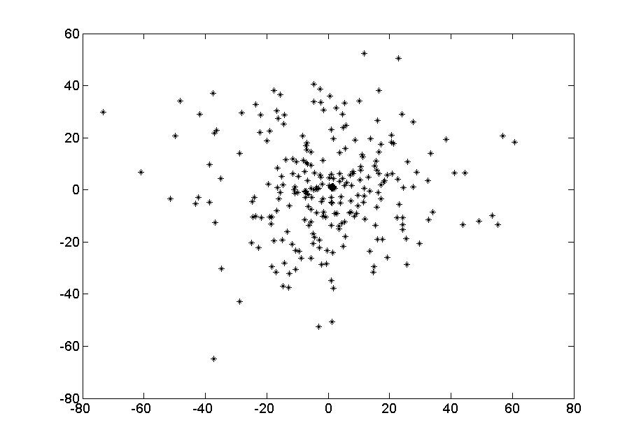
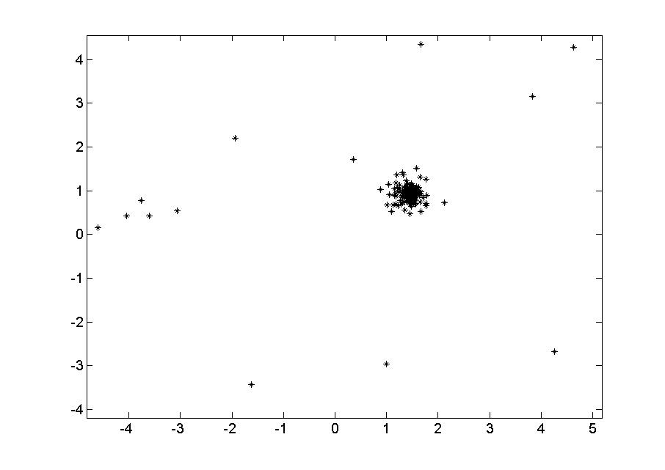
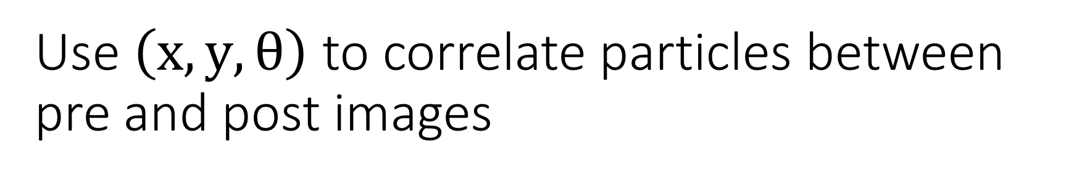
Use $\left(x,y,θ\right)$ to correlate particles between pre and post images
For each particle in the post image, find the nearest particle in the pre image.

Slide 8
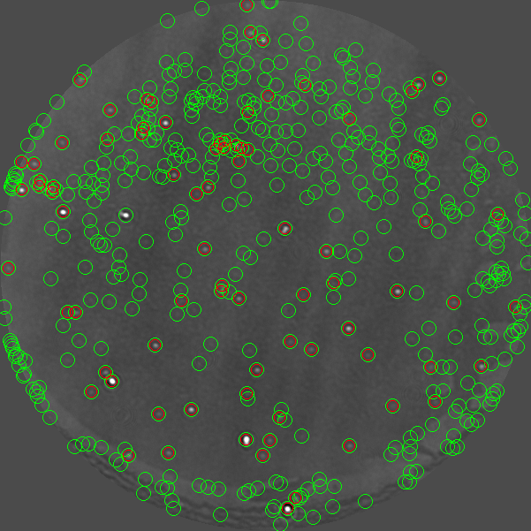
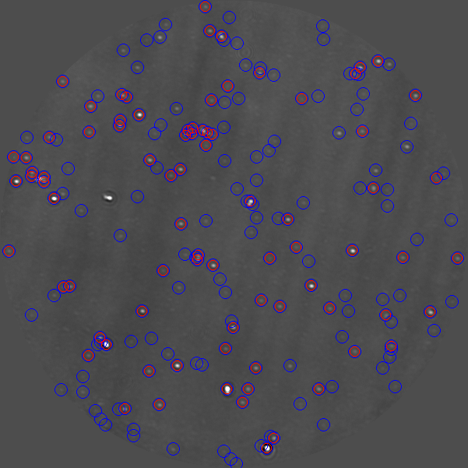
Comparing aggregate numbers is tricky, especially without histogram filtering
PRE POST

Slide 9
Next steps:
Quality test
Integrate with analysis workflow
First application – Rolling Circle Amplification
Particle size vs. amplification time
Sensitivity & specificity

